Slide 1
PYTHON PROJECT
TIC-TAC-TOE GAME with GUI

Slide 2
Submitted By: YASH KUMAR (11910683)
Roll. No. : B71
Reg.No : 11910683
Section: K19GE
Project Name: Tic Tac Toe game with GUI
Subject: INT-213 (Python Programming)
Group Members: None
Submitted To: Mr. Dipen Saini Sir

Slide 3
Table of contents
Introduction
Profile of the problem
Code screenshots
Output screenshots
Conclusion
Bibliography

Slide 4
INRODUCTION
In this Python project, I am going to make a Tic Tac Toe game using Pygame library. Python is a high-level, interpreted and general-purpose dynamic programming language that focuses on code readability. The syntax in Python helps the programmers to do coding in fewer steps as compared to Java or C++. The Python is widely used in bigger organizations because of its multiple programming paradigms. They usually involve imperative and object-oriented functional programming. It has a comprehensive and large standard library that has automatic memory management and dynamic features. We will be explaining all the pygame object methods that are used in this project. Pygame is a great library that will allow us to create the window and draw images and shapes on the window. This way we will capture mouse coordinates and identify the block where we need to mark ‘X’ or ‘O’. Then we will check if the user wins the game or not.

Slide 5
Profile of the Problem
About Tic-Tac-Toe game:
This game is very popular and is simple by itself. It is a two-player game. In this game, there is a board with n x n squares. In our game, it is 3 x 3 squares. The goal of Tic-Tac-Toe is to be one of the players to get three same symbols in a row - horizontally, vertically or diagonally - on a 3 x 3 grid.
The game is played by two individuals. First, we draw a board with a 3×3 square grid. The first player chooses ‘X’ and draws it on any of the square grid, then it is the chance of the second player to draw ‘O’ on the available spaces. Like this, the players draw ‘X’ and ‘O’ alternatively on the empty spaces until a player succeeds in drawing 3 consecutive marks either in the horizontal, vertical or diagonal way. Then the player wins the game otherwise the game draws when all spots are filled.

Slide 6
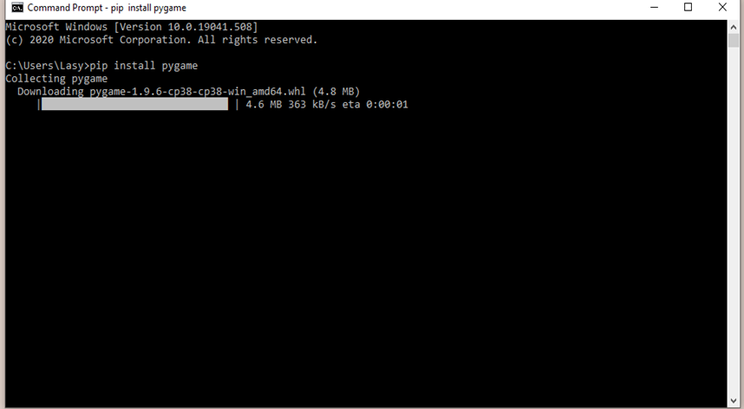
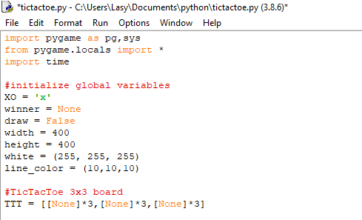
Code screenshots
Installing pygame
Initializing game components

Slide 7
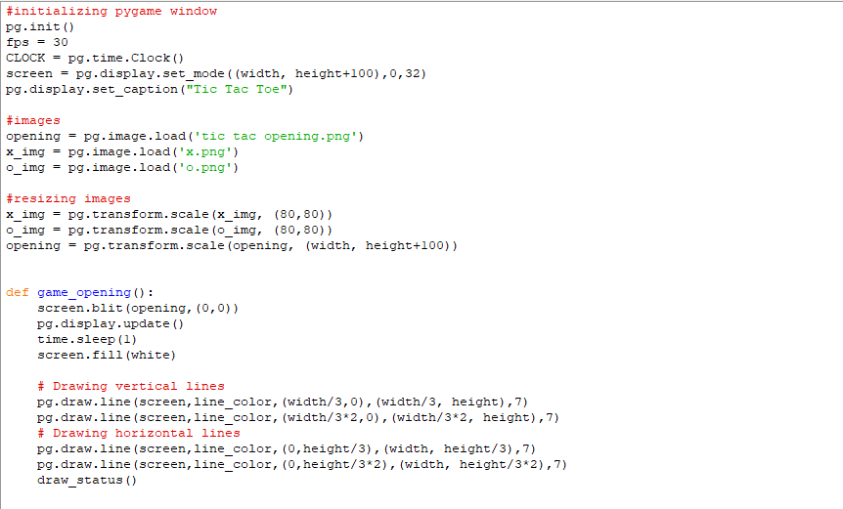
Code screenshots
Initializing Pygame window
Adding images and resizing them

Slide 8
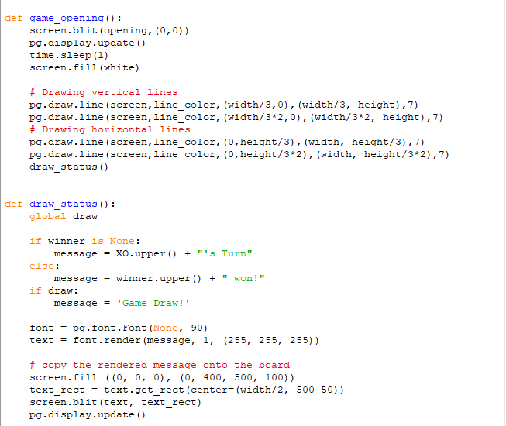
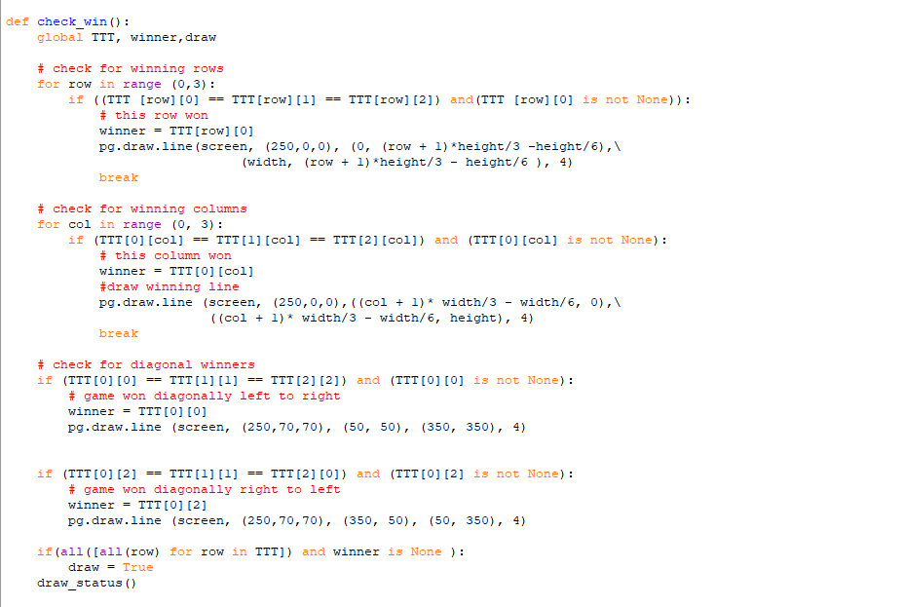
Code screenshots
Designing game display
Main algorithm

Slide 9
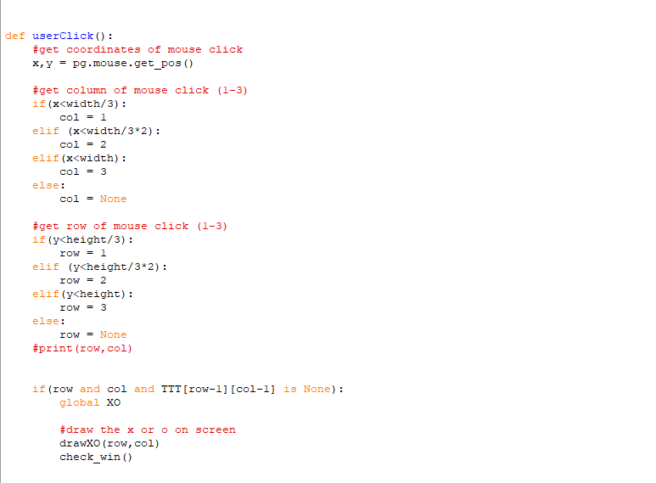
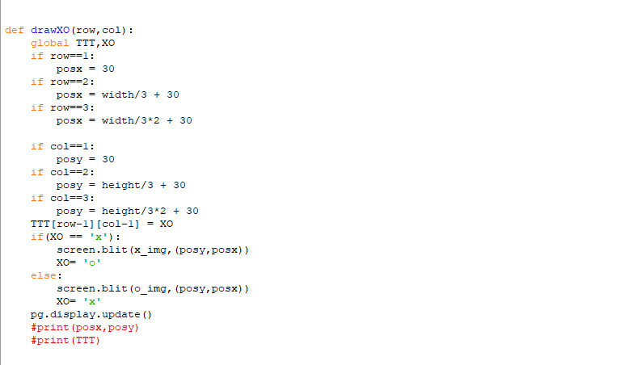
Code screenshots
Adding images and resizing them
Getting input

Slide 10
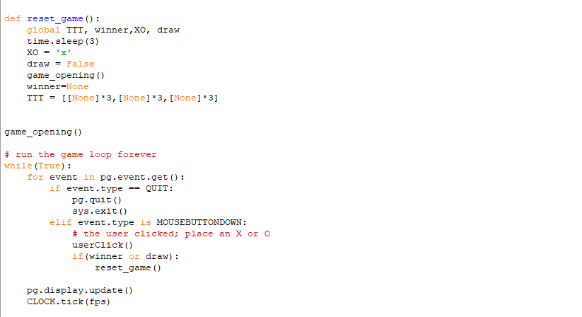
Code screenshots
Run the tic tac toe game forever

Slide 11
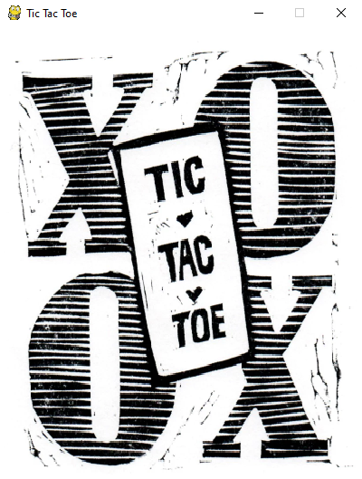
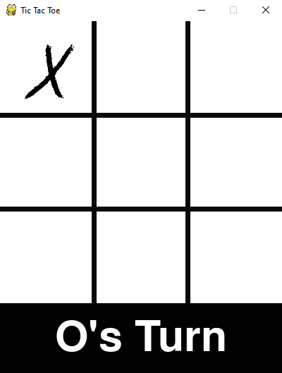
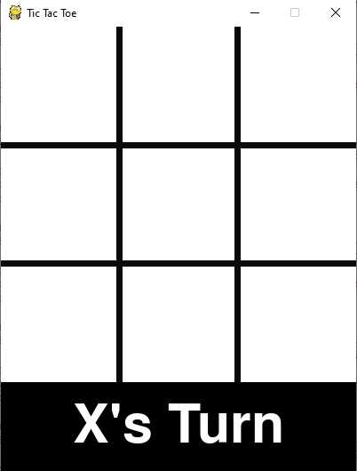
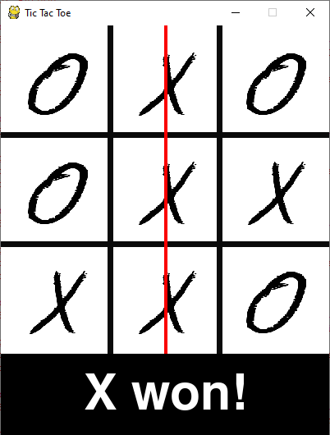
Output screenshots

Slide 12
Conclusion
In the conclusion of this project, I would like to say that Python is a fun and easy programming language and while creating a project like this, it has not just been a good experience but it also helped in the development of my creativity and logical thinking. I am looking to make more small game projects and would be more than happy to work on other projects in Python because it is just amazing to work with Python.

Slide 13
Bibliography
https://www.javatpoint.com/pygame
https://www.geeksforgeeks.org/tic-tac-toe-gui-in-python-using-pygame/

Slide 14
THANKYOU created by Yash Kumar (11910683)

